Slide 1
Design for testing and FA
Yariv Shlivinski

Slide 2
Design and Layout for failure
“Success is the ability to go from failure to failure without losing your enthusiasm.”

Slide 3
Design and Layout for testing, failure analysis and failure mitigation
Two kinds of tests:
  R&D
  Production line
Two kinds of FA:
  R&D+Q&R
  Field remote

Slide 4
Design and Layout for Lab testing

Slide 5
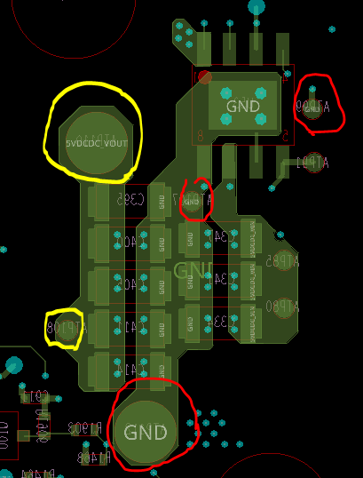
Test points
Lab
  For easy testing make sure to have TPs on the top side.
  GND TP close to the tested module.
  Try to make the TPs as accessible as possible.
  Do not sacrifice performance for testability!
    Stubs
    Noise collection.
D1999BB - PortiaX

Slide 6
Test points
ATE
  For injecting power and Electronic load connection use four ATPs for Kelvin connection.
  In case of high current make room for large ATP
  Default ATP is 60mil for 0.75mm pin at the fixture. Can be used for currents lower than 1.5Amp.
  If constraint may use 40mil pad it is not recommended.
D1999BB - PortiaX

Slide 7
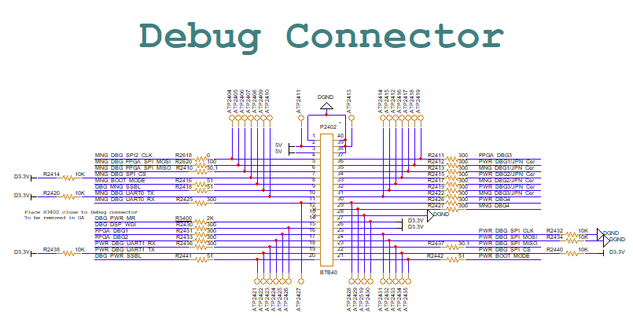
Test Points
Avoid direct galvanic contact of Test point with sensitive chips:
  MCUs, controllers, FPGA,….
  Place resistor between the ATP and pin.

Slide 8
Auxiliary
Secondary auxiliary
  Internal Low DC -> Low DC
  Only black box testing
  Need to be able to separate input and output for testing.
D1999BB - PortiaX

Slide 9
Auxilaiary
Main auxiliary:
  In most cases the output is a diode. It is easy to inject voltage at the output to test secondary power supplies.
  White box
  Need to measure internal parameters:
    Loop transfer function
    Gate signals
    Switch voltage
    Switch current?
    Input/output voltage/current.

Slide 10
Main Auxilaiary
Jupiter 3

Slide 11
Main Auxiliary
Add small serial resistance in feedback path.
  Network analyzer (Bode 100) connection point
AC_VREF
R427
470
R428
10
12V_AC_FB
U402
4
1
R431
FOD817A3SD
1K
R433
R432
R434
3
2
C425
*
68p
*
C428
1u
R437
210
2.5V_AC
10K
10K
49.9K
AC_FB
2
*
D410
1
2.5V_AC
R440
BAT54XV2
1000
R442
1
ZD400
R443
2
2.5V_AC
C436
C438
4.99K
LM431BIM
*
3K
3
1000n
47n
DGND

Slide 12
Bode 100
The following figure shows the feedback loop of the circuit and indicates the suitable injection point. The impedance looking backwards equals the output impedance of the converter which is very low (in the range of several mΩ). The impedance looking in direction of the loop is formed by the compensator and the voltage divider and is in the range of several kΩ.

Slide 13
Auxiliary Current FB
Do not add test points to CS.
  Current sense is very sensitive to noises. Avoid having stubs/antennas on that line.
3
1
D403
2
1N4148
R416
R412
2N7002KW
R415
13
4
*
*
1
R418
1K
AC_VREF
AC_PWM
R419
30
1
Q402
20
20
C405
R420
MSJU04N80A
2
Q401
100n
3
C406
10K
*
ACDC_CTRL-
100p
R421
C413
CS_AC
4.99K
2.2n
R422
R423
ACDC_CTRL-
1.3
1.3
U401
ACDC_VCC
7
UCC28C54
6
AC_PWM
AC_VREF
8
VDD
OUT
2
R425
20K
AC_FB
AC_Rt/Ct
4
VREF
FB
1
AC_COMP
R426
20K
ACDC_CTRL-
5
RT/CT
COMP
3
R429
1000
CS_AC
GND
CS
TP407
50% DUTY
AC_VREF
R438
1
D409
C432
30K
*
AC_COMP
AC_FB
AC_Rt/Ct
150p
BAV21
2
R440
Fsw=100kHz
2
1
MMBTA56
3
Q405
1000
C439
C438
100n
47n

Slide 14
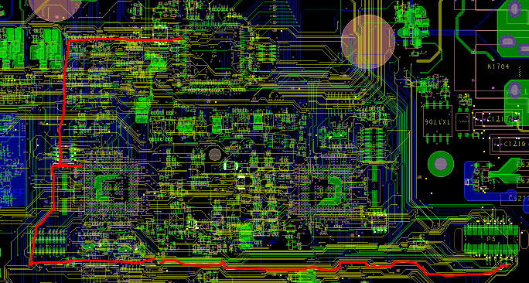

Debug card Connection V4
Debug Card is connected and used only in lab.
  When not used SPI lines become stubs and antennas. Signal is both distorted and collects noises.
FPGA
SPI
MNGR
PWR
DBG
SPI
SPI

Slide 15
Example V4
MNGR to Debug connector 20cm
FPGA to Debug 25cm
Solutions:
  Place Debug connector close to manager
  Use 0 ohm resistors to disconnect.
FPGA
SPI
MNGR
PWR
DBG
SPI
SPI

Slide 16

Example V4 (what we intended 🙂)
FPGA
SPI
MNGR
RES
PWR
DBG
SPI
SPI
16

Slide 17
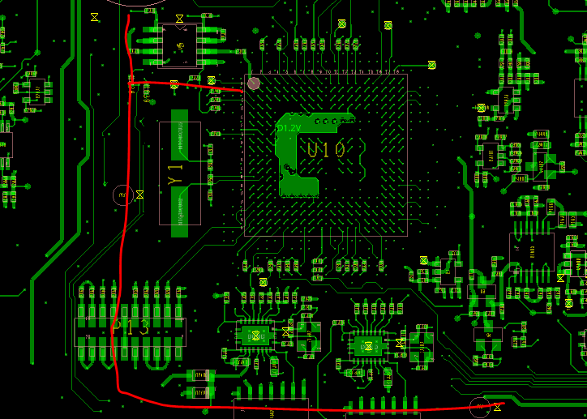
Example V4 (What we implemented ☹ )
Even best solutions should be implemented correctly.
MNGR
RES

Slide 18
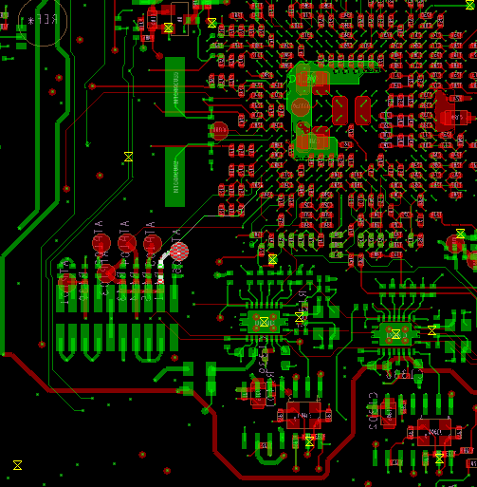
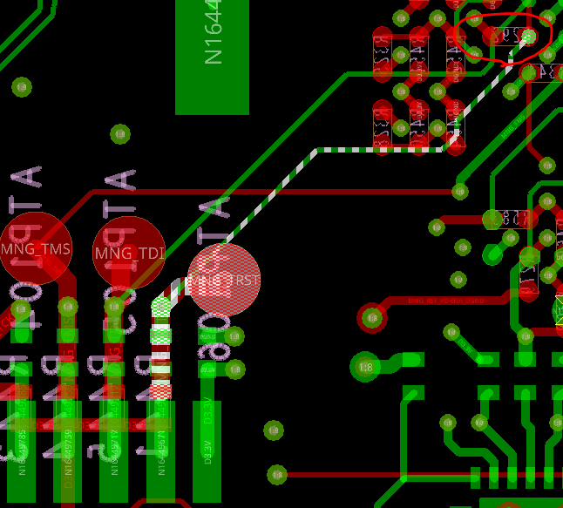
JTAG
JTAG resets the DSP
To avoid false RESET the line should be pulled as close as possible to the DSP pin.

Slide 19
Design for Failure analysis and prevention
“There are known knowns, things we know that we know;
and there are known unknowns, things that we know we don't know.
But there are also unknown unknowns, things we do not know we don't know.”
Donald Rumsfeld

Slide 20
Design for Failure analysis and prevention
Failure cannot be predicted
  What to measure?
  How much money/effort/space should we invest?

Slide 21
Temperature
Temperature is a good predictor and sign for system/device failure
Temperature sensing is easy to implement.
Sense lines tend to be long from power train to DSP.
  Noise peak-up and injection.
  Power planes cut through.
Clearance/creepage: Temperature sense lines are low voltage signals that are routed in high voltage areas.
  Solution: Use different layers for temp sense and power.
  Downside: Wasting power layers for telemetry.
Need to find the correct balance between telemetries and performance.

Slide 22
Temperature sensing
Place as much sensors as possible.
Temperature changes are slow, and signal is not sensitive.
Possible to use mux.
Standard telemetry does not support so many measurements but in case of need software may be changed and events added.

Slide 23
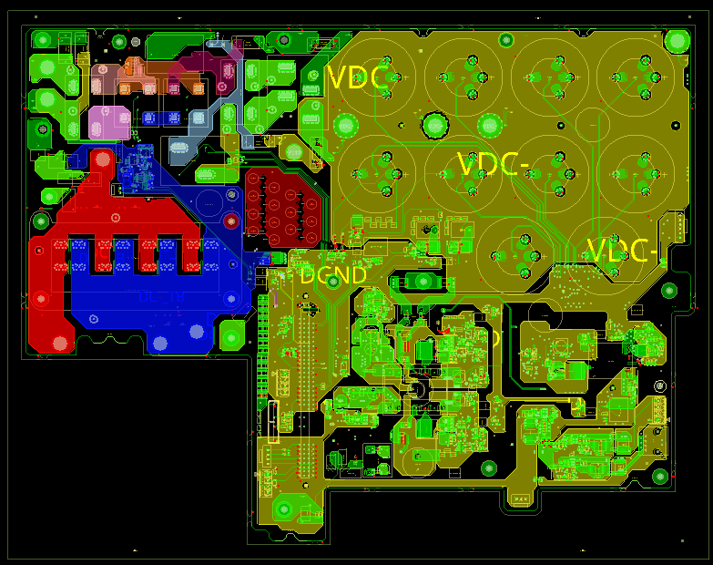
Temperature sensors V4

Slide 24
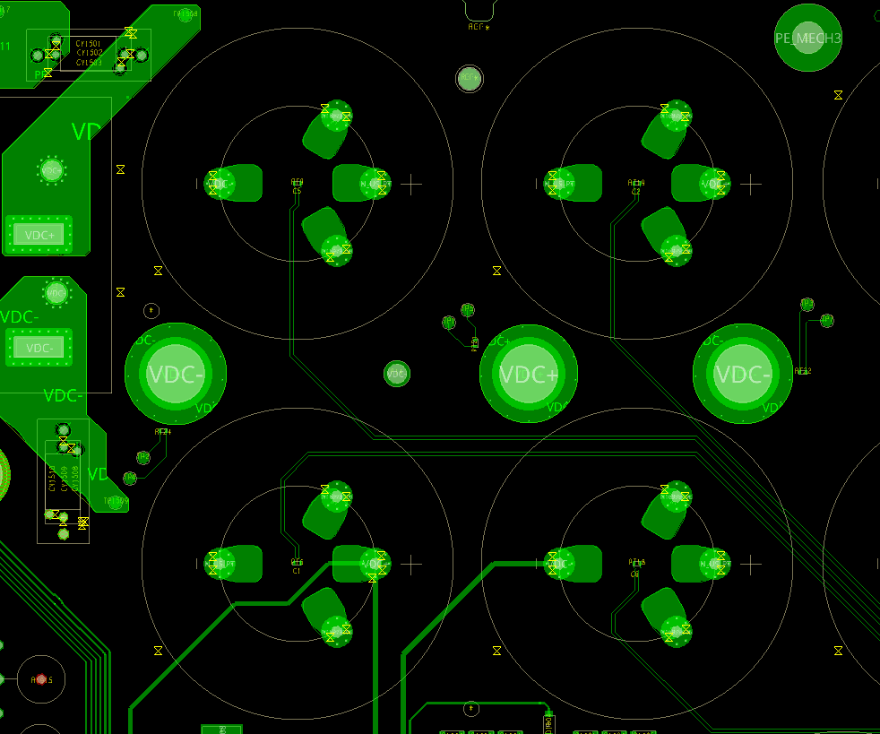
Temperature sensors V4

Slide 25
System Temperature measurement
System level testing
  What is the root cause?
Performance depends on ambient
  Need calibration temperature sensor
  Heat-sink measurement?
Sensor should be located as close as possible to device in question
  Which devices are most important?
  Clearance creepage.

Slide 26
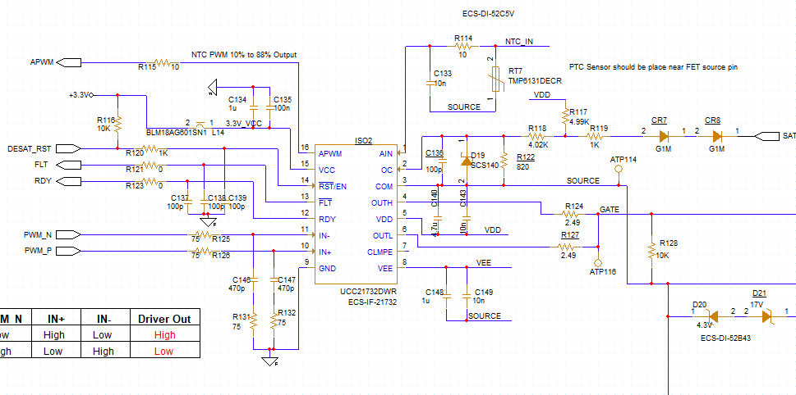
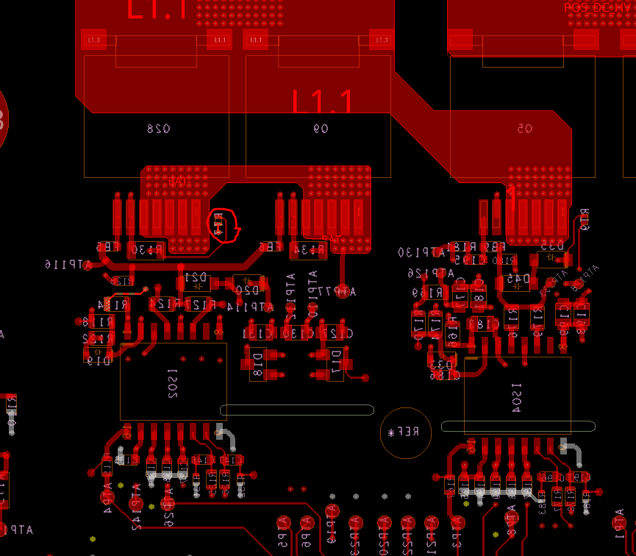
RSS2.5
Analog isolation
The driver has analog isolated port which translates high voltage domain signal to low voltage domain PWM

Slide 27
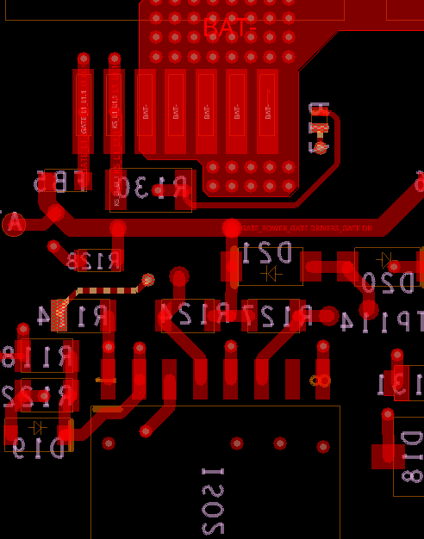
RSS2.5
Analog isolation

Slide 28
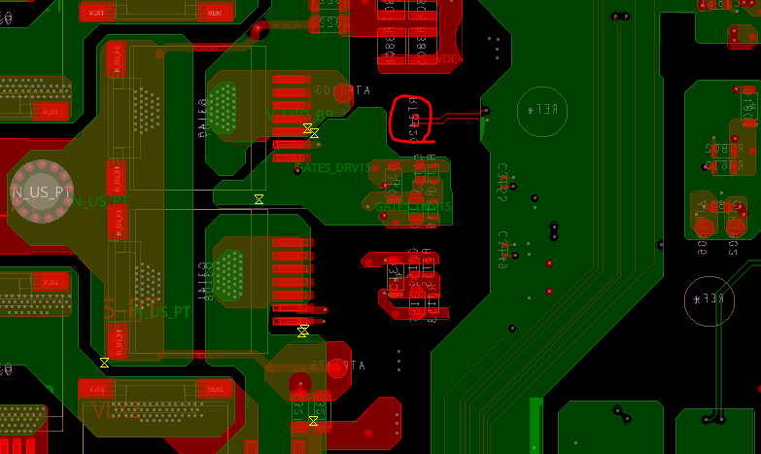
V4
Clearance and creepage require larger distance. How good is the thermal coupling.

Slide 29
Connector Temperature
Connectors are weak points.
  Power connector detachment can cause fire
  Connection deterioration is usually gradual
Solution:
  Measure temperature near the connection point.
  In case of deterioration impedance and temperature rise.
  How can we couple the sensor to the point of interest?

Slide 30
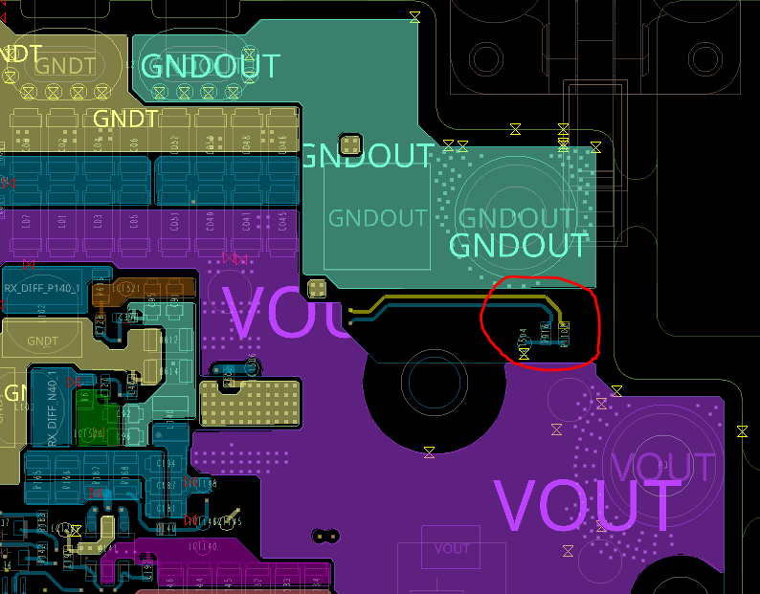
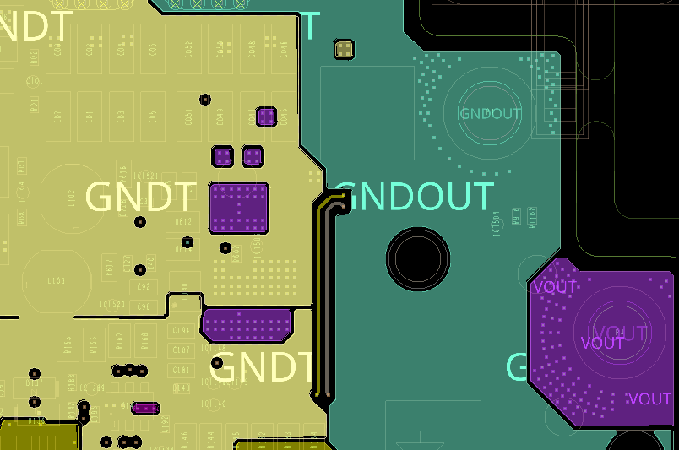
CTM (H1300)
Maximum metal around thermistor
For optimizers clearance creepage requirements are low.

